Slide 1
Our learning framework
Ways of working in our learning organisation

Slide 2
Introduction
Our learning framework
As a council, we’re embedding a learning framework to support and demonstrate our journey to become a learning organisation.

Slide 3


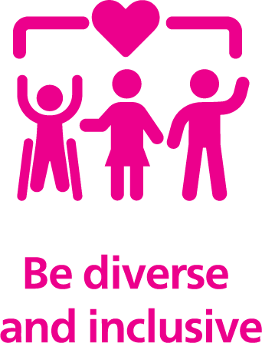
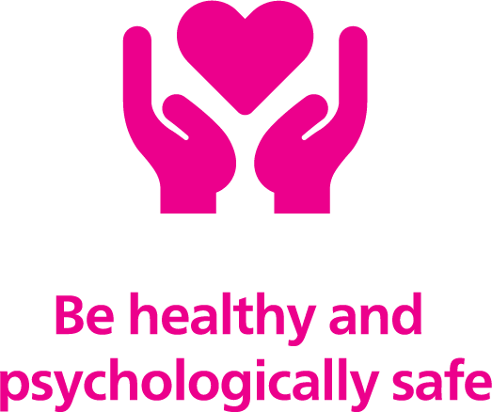
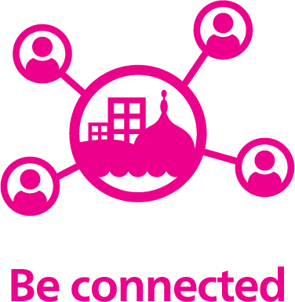
Introduction
Our learning framework
As a council, we want to:

Slide 4
Be connected
Our learning framework
Being connected means we work as one council, with all
directorates, services and staff aligned to the clear purpose
of creating a better Brighton & Hove for all.
Our leadership will bring together resources from across the
organisation so we can work together to address our challenges.
Our staff will feel empowered, with decisions made as close to the front line as possible.

Slide 5
Be confident
Our learning framework
Being confident means we are agile, testing our approach
to problems and learning to improve as we go.
It means we view mistakes as learning experiences we
can grow from, and that we are comfortable working
through complex issues in the knowledge we have the support we need.
We will support the development of digital skills to ensure staff can use the tools they need and empower others to work confidently.

Slide 6
Be innovative and creative
Our learning framework
Being innovative and creative means we make space to
experiment and reflect.
We will use data to inform our decisions, influencing and
leading in developing creative policy that will change the
lives of our residents.
We will embrace artificial intelligence (AI) and new tech to support efficiency and deal with complexity.

Slide 7
Be diverse and inclusive
Our learning framework
  Being diverse and inclusive means we have a dynamic
  workforce and leadership that truly reflects our city’s
  communities.
  We will embed the belief that everyone can grow
  and learn.
  We will create a diverse leadership made up of staff from all ages and career stages.

Slide 8
Be healthy and psychologically safe
Our learning framework
Being healthy and psychologically safe
means we work in a trust-based environment
where staff feel able to bring their best selves
to work.
It means we have a resilient workforce equipped
with the necessary tools and resources to look after its health and wellbeing.

Slide 9
Our learning framework
Find out more
Search ‘Our learning framework’ on The Wave.

